Slide 1

The View Transformation
CS 418: Interactive Computer Graphics
UNIVERSITY OF ILLINOIS AT URBANA-CHAMPAIGN
Eric Shaffer

Slide 2
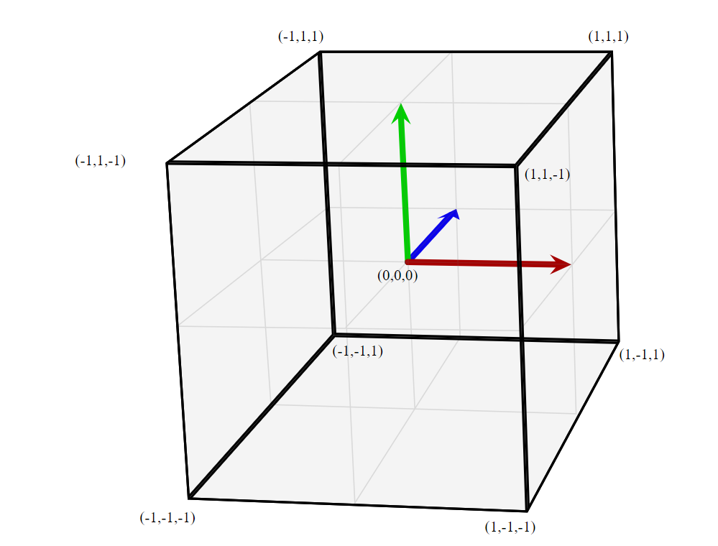
WebGL and Camera Views
WebGL renders geometry in a 2x2x2 axis aligned box centered at the origin
This is like having a camera in a fixed position
So…how can we render arbitrary views of our geometry?
Bonus Questions:
What is the “handedness” of WebGL clipspace?
What is the handedness of the world coordinate system used by WebGL systems?

Slide 3
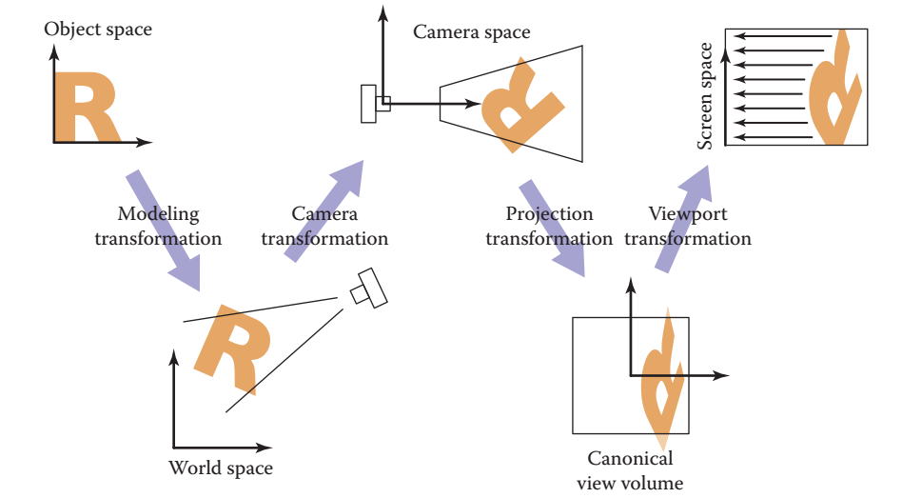
Graphics Pipeline
We will call the camera transformation the view transformation
In WebGL convention, the projection transformation inverts the handedness of the coordinate system
The canonical view volume is a 2x2x2 box centered at the origin with coordinates ranging from [-1,-1,-1] to [1,1,1]

Slide 4
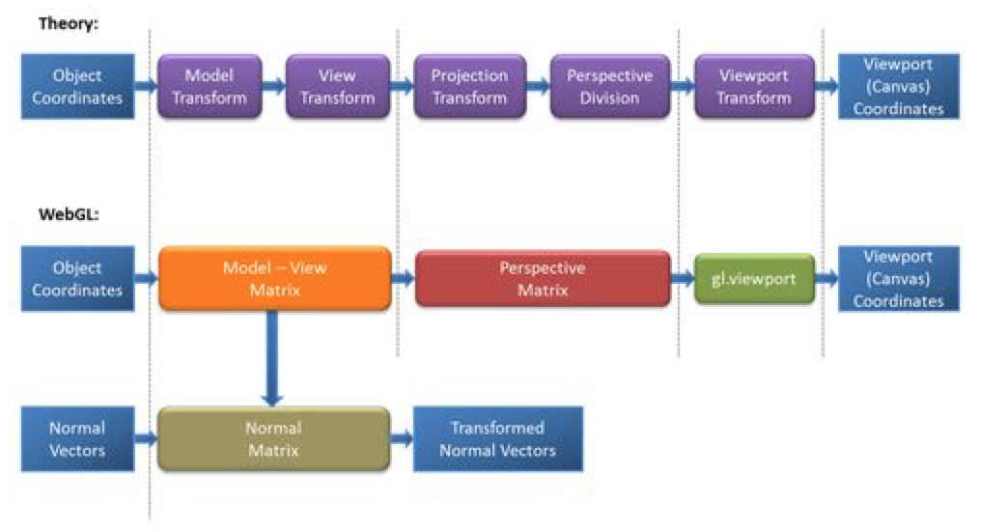
Graphics Pipeline and WebGL
From WebGL Beginner’s Guide by Cantor and Jones
What boxes in the theory diagram does this code correspond to?
gl_Position = uPMatrix*uMVMatrix*vec4(aVertexPosition, 1.0);

Slide 5
Graphics Pipeline
Model Coords
Model Xform
World Coords
Viewing Xform
Viewing Coords
Perspective Distortion
Homogeneous Divide
Still Clip Coords.
Clipping
Clip Coords.
Window
Coordinates
Window
to
Viewport
Viewport
Coordinates

Slide 6
Viewing
We often will want to allow the view of our 3D scene to change
We can do so using by applying affine transformations to the geometry
A view matrix is functionally equivalent to setting up a camera location in world space. It is a transformation matrix like the Model matrix, but
Happens after the modeling transformation
It applies the same transformations equally to every object

Slide 7
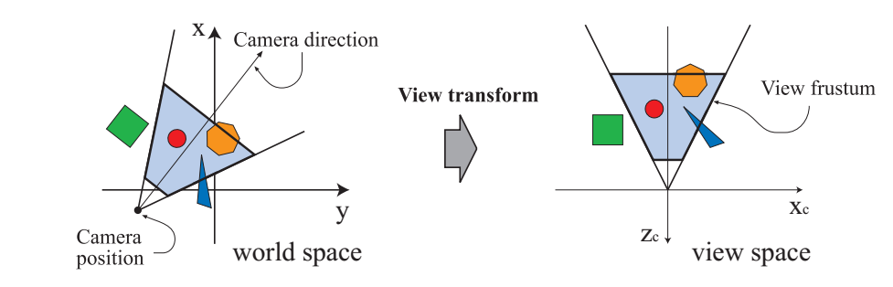
Viewing
The engines don’t move the ship at all. The ship stays where it is and the engines move the universe around it.
-- Futurama
WebGL really only ever renders one viewpoint…looking down the Z axis through the [-1,-1,-1]x[1,1,1] view volume
So, to see a different view, we need to move everything in the world so that
The camera location is moved to the origin
The view direction of camera lines up with the z axis

Slide 8
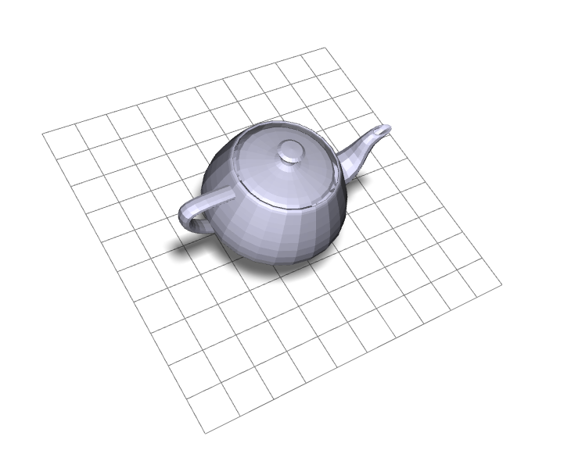
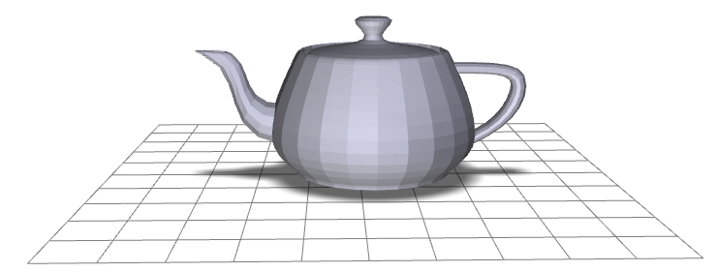
Viewing Transformation
eye point
lookat point
y
y
x
x
z
Screen Coords
Clip Coords
Viewing Coords
World Coords
Model Coords

Slide 9
Creating a LookAt Function
Suppose we want to implement a function that sets up a view
There are lots of possible ways to do this…we’ll choose a simple lookat camera
The API we create will require a someone using the function to specify:
The eyepoint (or camera location)
The lookat point (a point in the view direction)
An ”up” vector that we use to specify rotation around the view vector

Slide 10
Deriving the Viewing Transformation
One way to think about what you are doing
Translate the eyepoint to the origin
Rotate so that
lookat vector aligns with –z axis (OpenGL/WebGL)
up aligns with y
We move all objects (the world) this way…
Another way to think of it
Create an orthonormal basis with eye at the origin
And vectors u, v, w as the basis vectors
…and then align u,v,w with x,y,z

Slide 11
Local Frames
A frame has an origin point and set of basis vectors
Any point can be expressed as coordinates in such a frame
For example (0,0,0) and <1,0,0>, <0,1,0>,<0,0,1>
And an example of a point in that space: (4,0,0)= (0,0,0) + 4 <1,0,0> + 0 <0,1,0> + 0 <0,0,1>

Slide 12
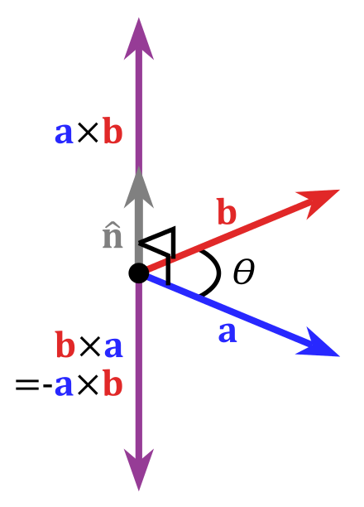
Cross Product of Two Vectors
Important Property: The cross product yields a vector orthogonal to the original two vectors

Slide 13
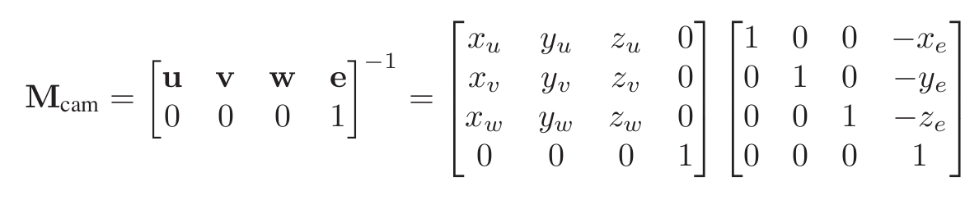
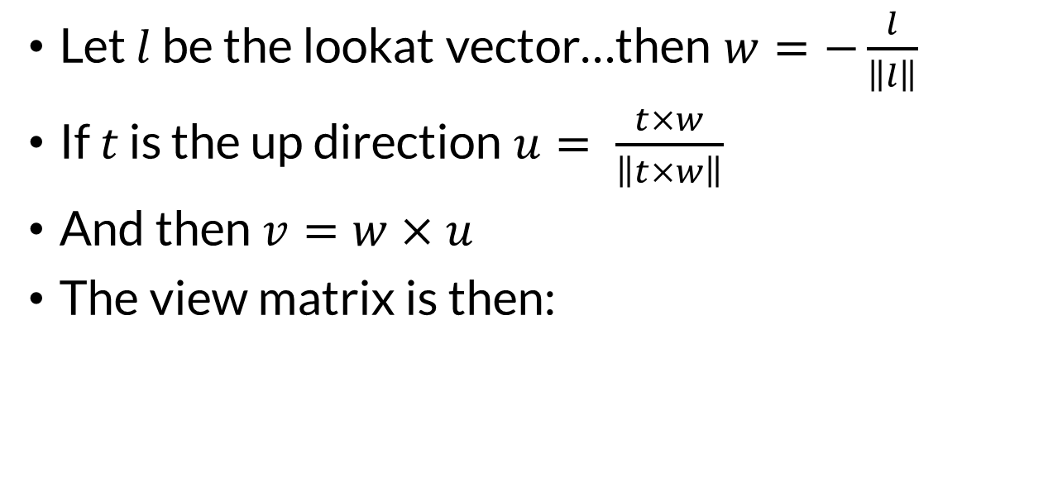


The Orthonormal Basis for View Space
$$l=lookatPoint−eyepoint$$
Let $l$ be the lookat vector…then $w=−\frac{l}{\left\|l\right\|}$
If $t$ is the up direction $u= \frac{t×w}{\left\|t×w\right\|}$
And then $v=w×u$
The view matrix is then:
$$M_{view}=$$
Why do we negate the lookat vector when computing w?

Slide 14
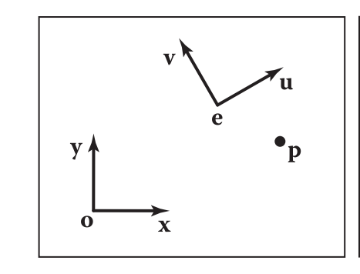
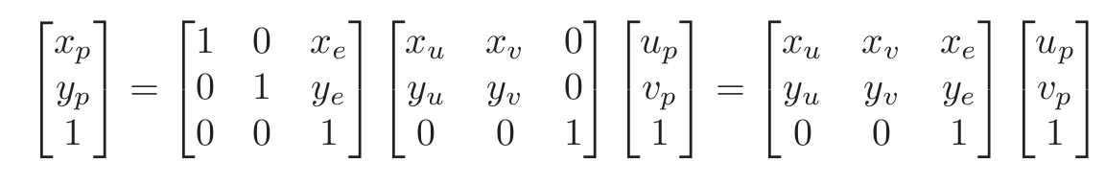
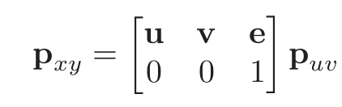
Moving Between Frames in 2D
How would we convert from (x,y) to (u,v)?
To convert coordinates from (u,v) space to (x,y) we can:
This can be written as

Slide 15

View Transformation
You can now look at your scene from any
Position
Orientation (almost)
What lookat and up vector pair won’t work?
…just uses a matrix multiplication
$$M_{view}=$$

Slide 16
glMatrix lookAt transform
{mat4} mat4.lookAt(out, eye, center, up)
Generates a look-at matrix with the given eye position, focal point, and up axis
Parameters:
{mat4} out
mat4 matrix will be written into
{vec3} eye
Position of the viewer
{vec3} center
Point the viewer is looking at
{vec3} up
vec3 pointing up
Returns:
{mat4} out
glMatrix can compute a lookAt transformation for you
How would you implement a moving camera?
What key difficulties would you need to handle?

Slide 17
Let’s review viewing….
We start out by setting up our geometry in world coordinates
Which transformation does this?

Slide 18
The view transformation
We pick a specific viewing position and direction in worldspace

Slide 19
The view transformation
We transform the world so the view position is at the origin. The view direction is down the –z axis in WebGL

Slide 20
The projection transformation
We pick a viewing volume. This is specified in viewing coordinates.

Slide 21
The projection transformation
Our view volume is transformed to fit in the WebGL view volume
The WebGL view volume is a box with clip planes at -1, +1
The z coordinates are negated to flip the z-axis

